Slide 1


Introduction to
Robotic Process Automation
Job Searching portal and Resume review bot
220701127
Keerthika S
Mrs. J . Jinu Sophia
Assistant Professor(SG)

Slide 2
Abstract
The Job Finder and Resume Review System automates job searching and resume evaluation using UiPath. It scrapes job listings from multiple websites, organizes them into an Excel file, and sends the results via email. The system also analyzes uploaded resumes against job-related keywords, providing a relevance score to improve job matching. This solution saves time, reduces manual effort, and enhances efficiency, offering a smarter way to navigate the job market.

Slide 3

Need for the Proposed System
Job searching and resume evaluation are time-consuming and repetitive tasks that require navigating multiple websites and tailoring resumes for specific roles. These manual processes often lead to inefficiencies, missed opportunities, and frustration for job seekers.

Slide 4
Advantages of the Proposed System
The Job Finder and Resume Review System addresses these challenges by automating:
Job Search: Collecting and organizing job listings from multiple platforms.
Resume Review: Analyzing resumes for relevance using keyword matching.
This system saves time, ensures accurate results, and improves the job application process, providing a streamlined and efficient solution for job seekers.

Slide 5
Literature Survey
Paper 1: Automation in Job Search Platforms
Advantages:
Automates job data collection from multiple sources, saving time.
Provides structured and organized results for better decision-making.
Reduces errors in manual job searches by automating repetitive tasks.
Disadvantages:
Limited to specific job portals, reducing coverage.
Data scraping challenges due to website updates or restrictions.
Lack of advanced filtering options for tailored results.

Slide 6
Main Objective
The main objective of the Job Finder and Resume Review System is to simplify and automate the job search and resume evaluation processes. This system aims to:
Automate Job Search: Collect job postings from multiple websites, organize them in an Excel file, and send them to users via email for quick and easy access.
Enhance Resume Review: Analyze resumes by comparing their content with job-related keywords to provide a relevance score, helping users improve their resumes for better job matching.

Slide 7
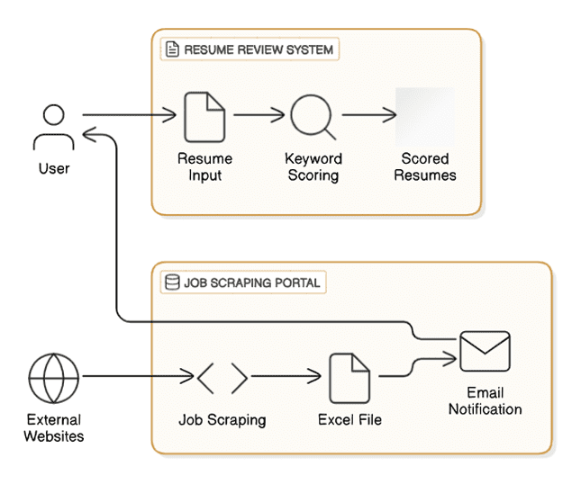
Architecture

Slide 8
System Requirements
Hardware Requirements
Processor: Intel i5 or higher
RAM: 8GB or more
Storage: Minimum 20GB free space
Software Requirements
RPA Tool: UiPath Studio
Database: Microsoft Excel (for data storage and organization)
Email Client: Microsoft Outlook (for email automation)
Web Browser: Google Chrome or Microsoft Edge (for job scraping)
Additional Plugins: UiPath browser and Excel activities

Slide 9
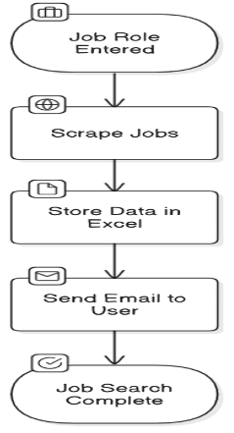
Functional Description
Module 1: Job Scraping
User inputs job role.
Bot opens job portal in browser.
Bot scrapes job postings.
Data is saved in Excel.
Bot sends the Excel file to the user via email.

Slide 10
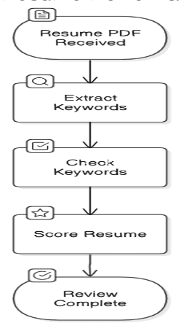
Functional Description
Module 2:Resume Review
User uploads a resume.
Bot extracts text from the PDF.
Bot compares the text with a job keyword database.
Bot calculates a relevance score.
Bot displays or sends the score to the user.

Slide 11
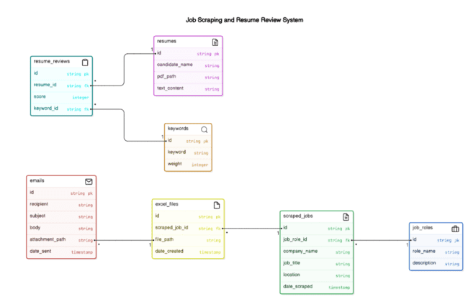
Table Design

Slide 12
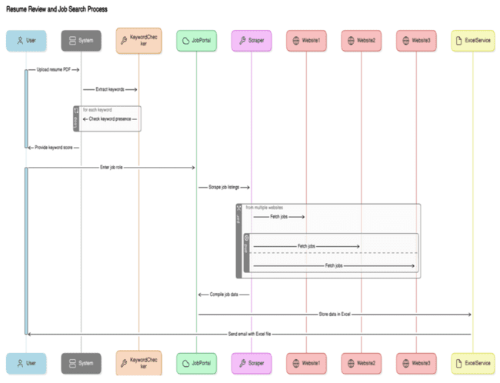
Process Design

Slide 13
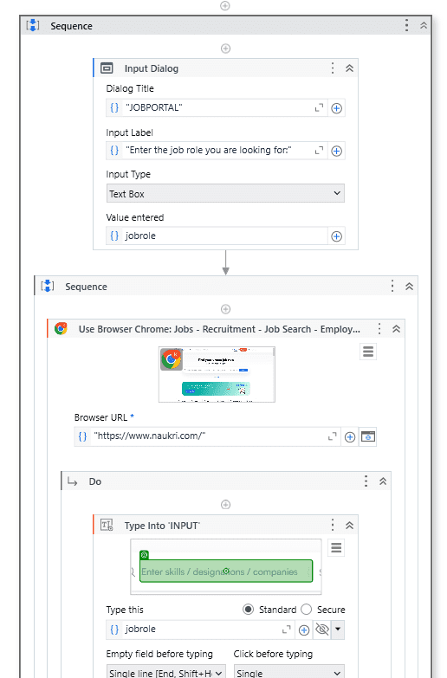
Implementation
JOB SEARCHING PORTAL

Slide 14
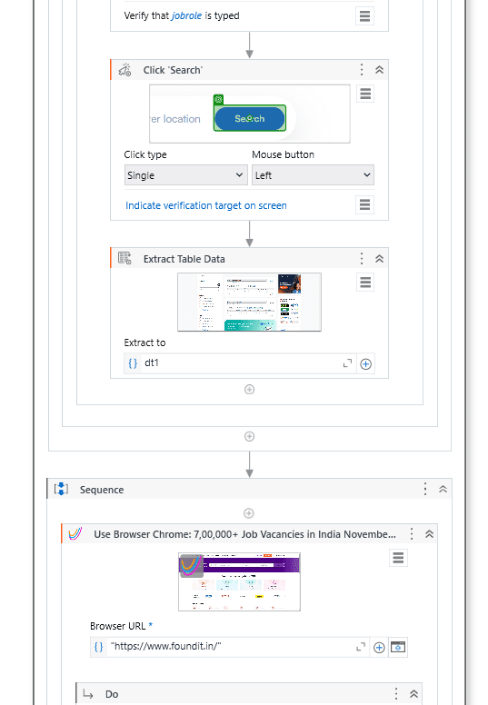
Implementation

Slide 15
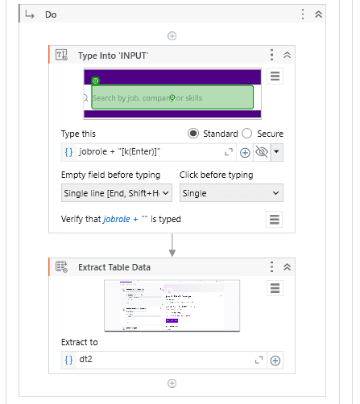
Implementation

Slide 16
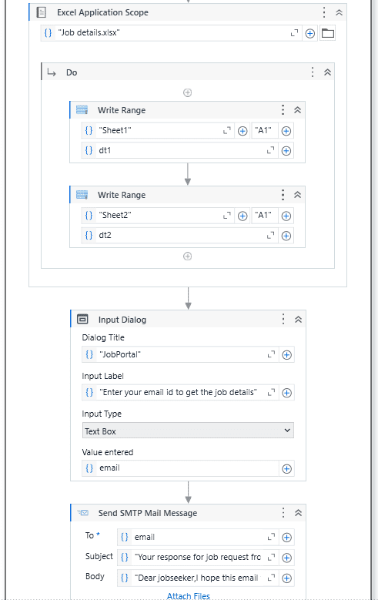
Implementation

Slide 17
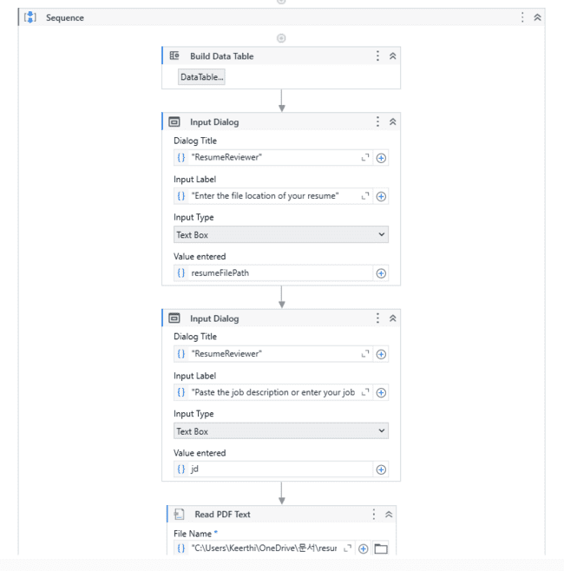
Implementation
RESUME REVIEWER:

Slide 18
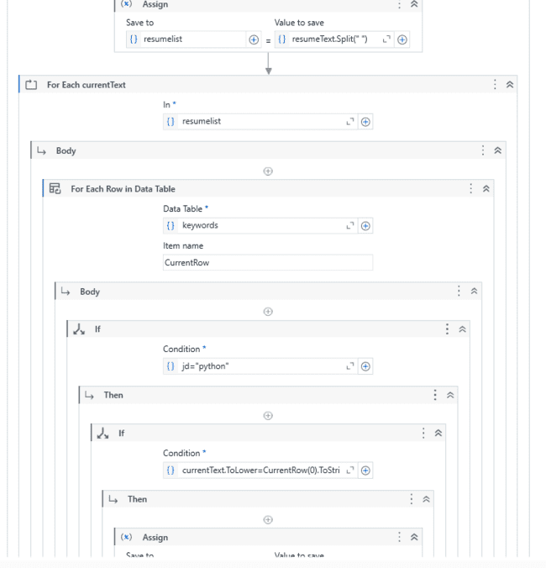
Implementation

Slide 19
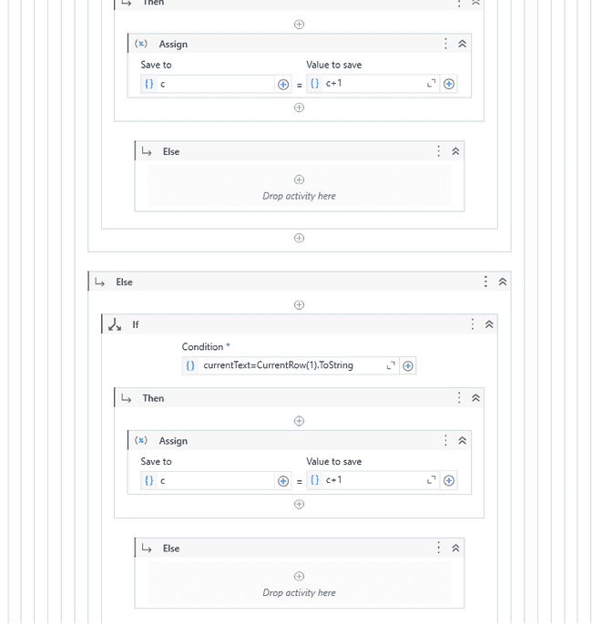
Implementation

Slide 20
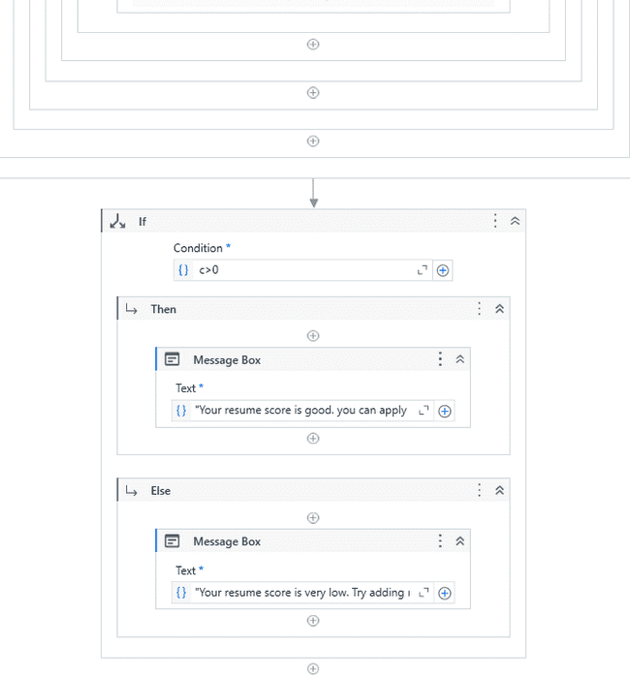
Implementation

Slide 21
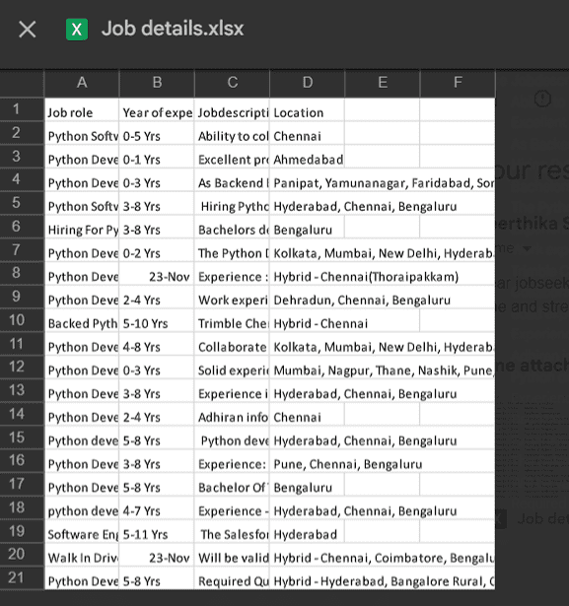
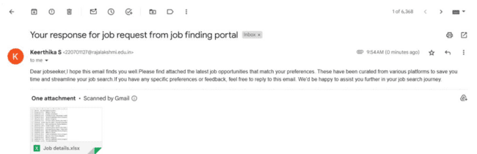
Testing
JOB SEARCHING PORTAL:
TESTING WITH OUTPUT:
Mail with excel file response
Attached excel file

Slide 22
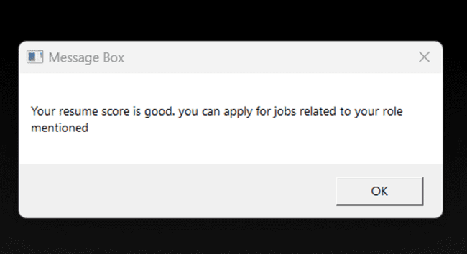
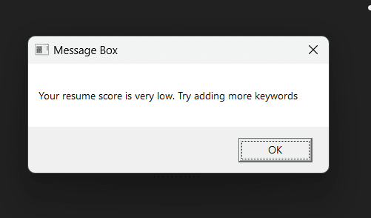
Testing
RESUME REVIEWER:
TESTING WITH OUTPUT:
Output if the resume has maximum keyword
Output if the resume has less keyword

Slide 23
Conclusions
The Job Finder and Resume Review System automates job searches and resume analysis to save time and effort for job seekers. It scrapes job details from websites, organizes them in Excel, and emails them to users. The system also evaluates resumes by matching content with job-related keywords, providing a relevance score to help users improve their chances. This solution simplifies the job application process, making it faster and more efficient.

Slide 24
Future Enhancement
Integration with More Job Portals
AI-Powered Resume Feedback
Real-Time Job Alerts
Enhanced Data Visualization
Multi-Language Support
Mobile Application Integration

Slide 25
IEEE Paper
Title: Implementation of Web Scraping on Job Vacancy Sites Using Regular Expression Method
link
Authors: Fitriono Arya Riski; Nungki Selviandro; Monterico Adrian

Slide 26
References
UiPath Forum: The UiPath Forum community where users share their experiences and solutions.
https://forum.uipath.com/
2. UiPath Documentation: The official documentation of UiPath features and functionalities
https://docs.uipath.com/

Slide 27
QUERIES:
JOB SCRAPING PORTAL:
How does the bot ensure accurate data extraction from websites?
Can the system be extended to include more job portals?
How frequently can the bot scrape data for updated job postings?
RESUME REVIEWER:
What types of keywords are used for scoring resumes?
How does the system handle non-standard resume formats?
Can users customize the keyword database based on specific job roles?

Slide 28
Thank You

